Slide 1

StepX1Edit Facade Studio: An AI-Powered Platform for Architectural Facade Design
AMIT Institute
Mai Farahat & Aya Hashem
9/2025

Slide 2
Contents
Motivation
User Interface
Problem & Solution
System architecture
Roadmap & Timeline
Models & Methods
Limitations & Future Work
Conclusion
01
05
02
06
Demo
03
07
04
08
09

Slide 3
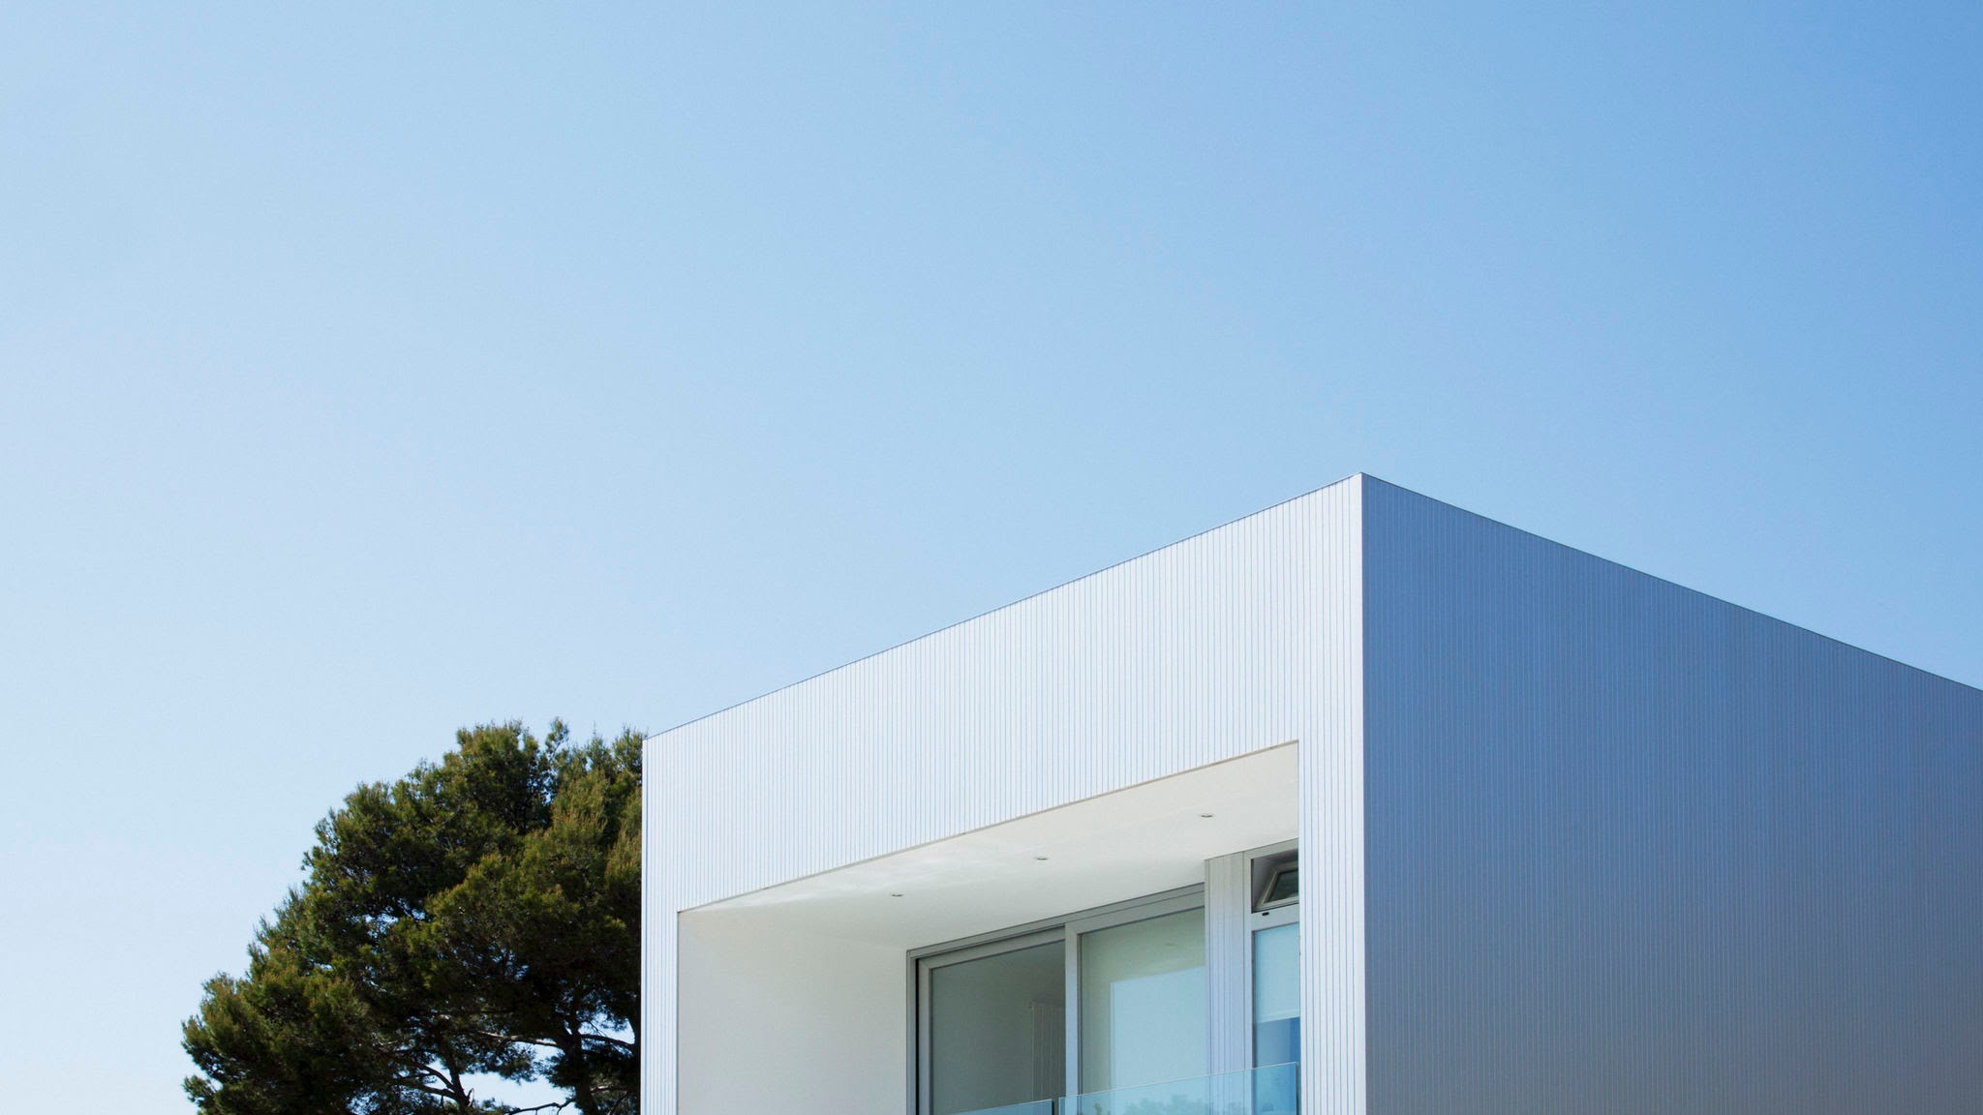
Motivation
Architects spend a lot of time exploring design variations manually. This process can be expensive and slow. With AI, we have the opportunity to create new facade concepts much faster, making early design exploration more efficient. That’s the problem we’re addressing.
Our goal is to combine two AI capabilities: image generation from text prompts and editing images based on natural language instructions. Together, these allow architects to quickly generate new facades and then refine them interactively, all within a user-friendly system.

Slide 4
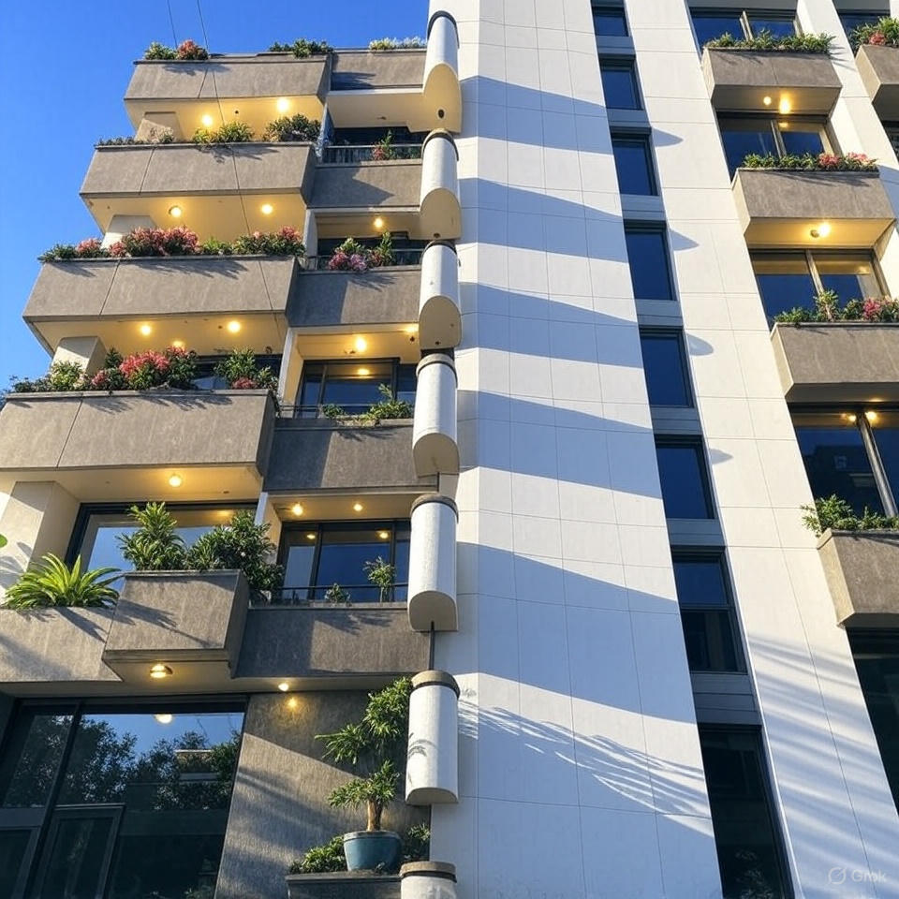
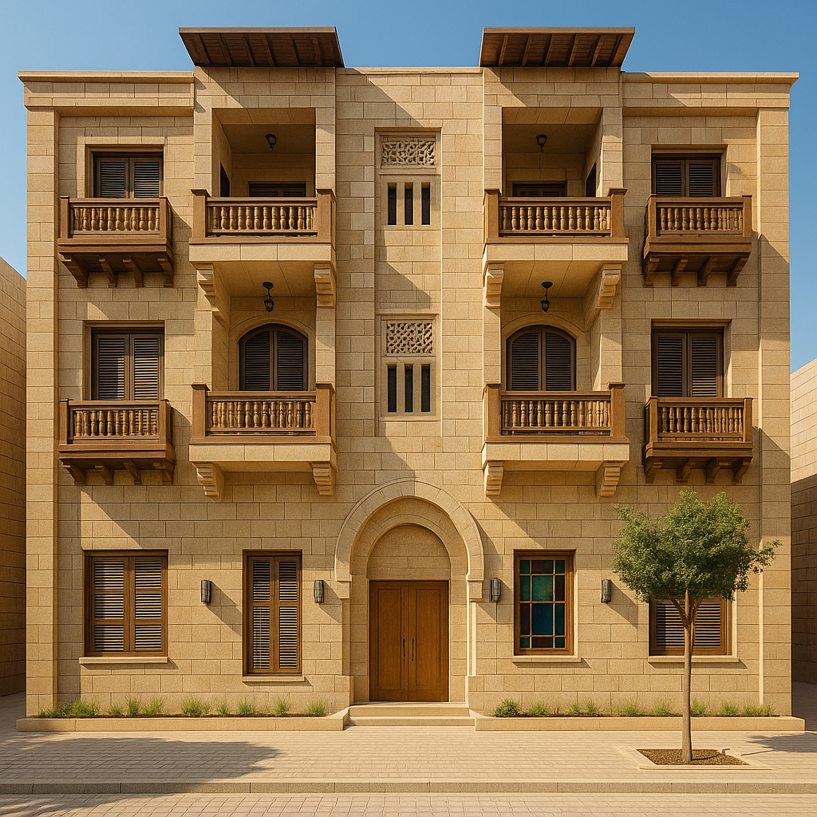
Architects Struggle to Explore Multiple Design Variations Quickly
Problem 1
Problem 2
Architects and design firms spend significant time and resources creating and revising facade designs
Smaller firms may struggle to compete because they lack resources for extensive design exploration.

Slide 5
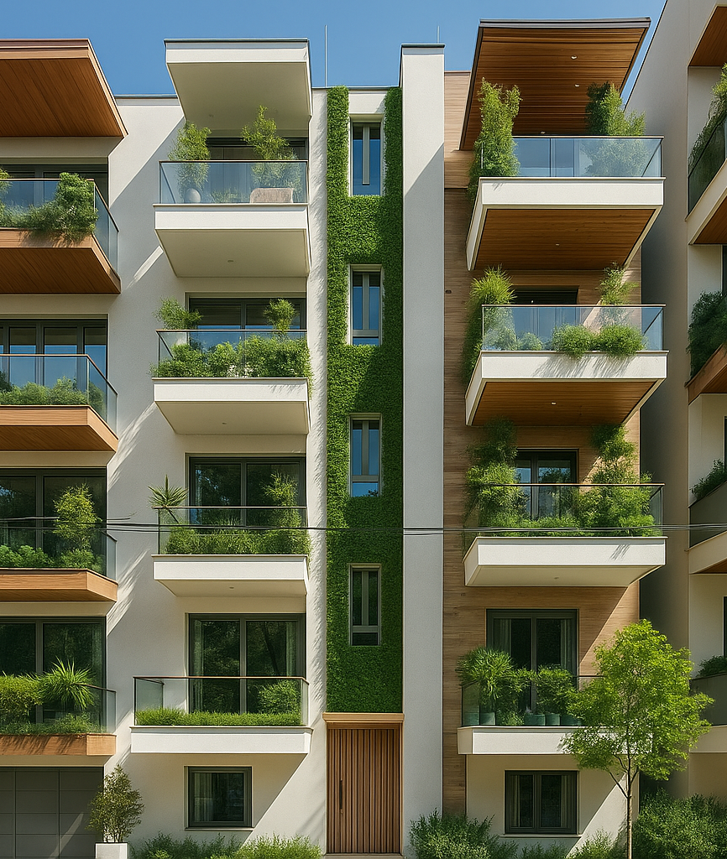
The solution
By creating StepX1Edit Facade Studio, an AI-powered platform that lets users generate, edit, and refine facades rapidly using natural language — saving time, reducing costs, and empowering architects to explore more creative possibilities..

Slide 6
System Architecture
Did edit succeed?
Start
Input
Text prompt / Existing image
Apply SDXL-Turbo + Step1X-Edit
Generate High-Quality Facadet
Save / Display results in Gradio UI
End
YES
NO
fallback to Instruct-Pix2Pix

Slide 7
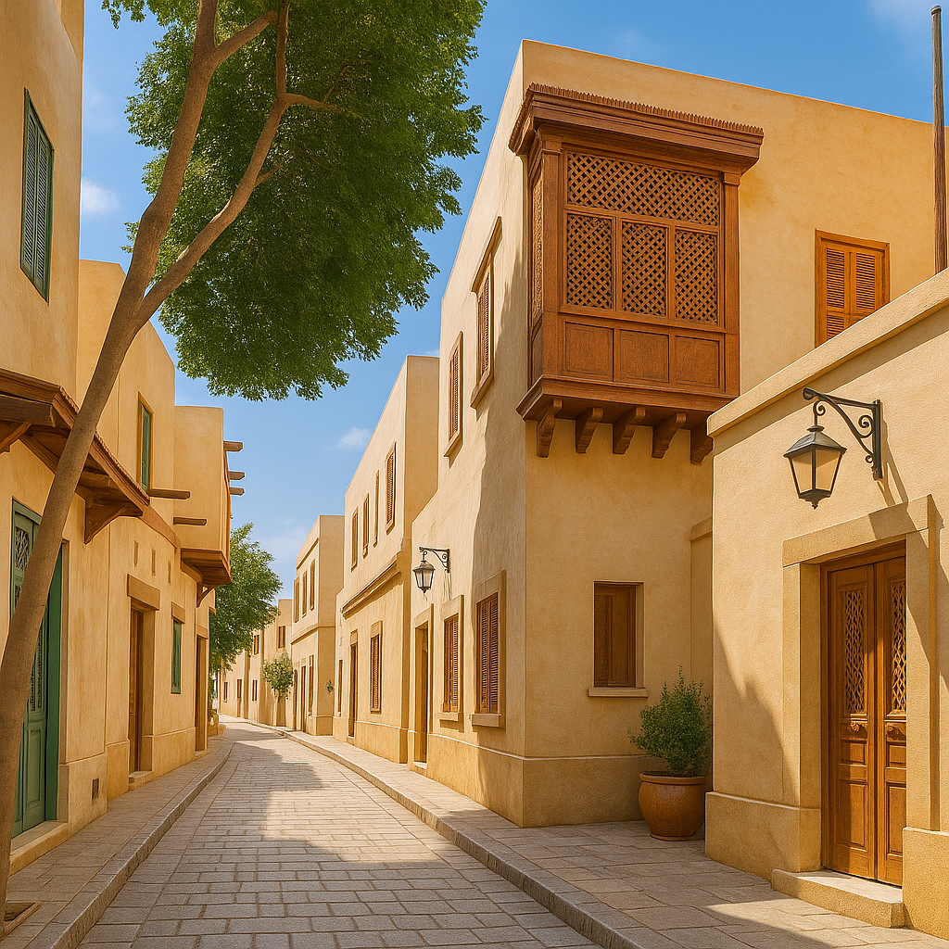
Models & Methods
We used SDXL-Turbo because it generates high-quality images very quickly. For editing, we rely on Step1X-Edit, which can follow text instructions to modify specific parts of a facade. In more challenging cases, we fall back on Instruct-Pix2Pix. We also optimized everything for GPU performance, using mixed precision so the system runs efficiently.
01
02
03
Step1X-Edit
Instruct-Pix2Pix
SDXL-Turbo
fast, high-quality image generation.
edit facades based on user instructions
fallback for complex edits.

Slide 8
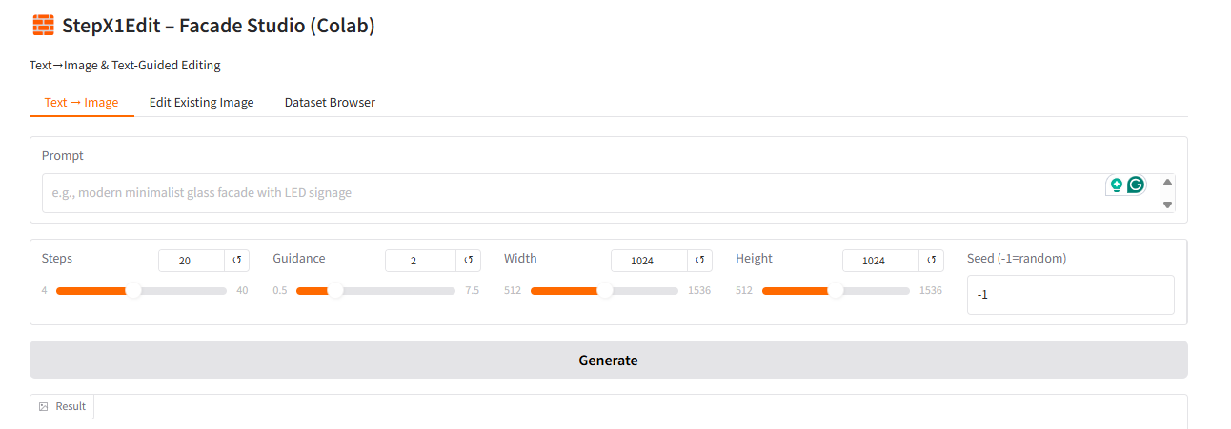
User Interface
To make this practical for architects, we built a Gradio interface. It has three tabs: one for generating facades from scratch, one for editing existing images, and one for browsing the dataset. Users can try things interactively or even run batch processing if they want multiple outputs at once.
Text-to-Image (generate facades)

Slide 9
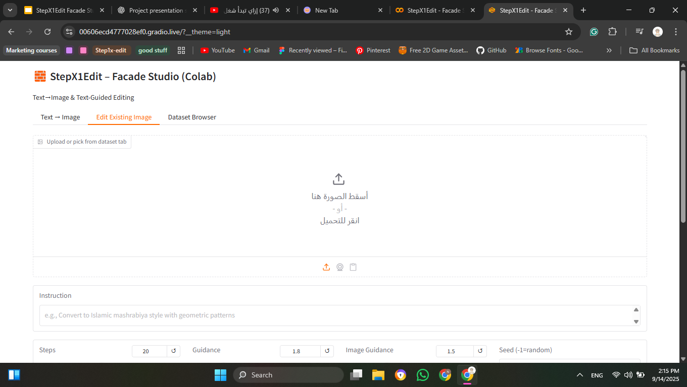
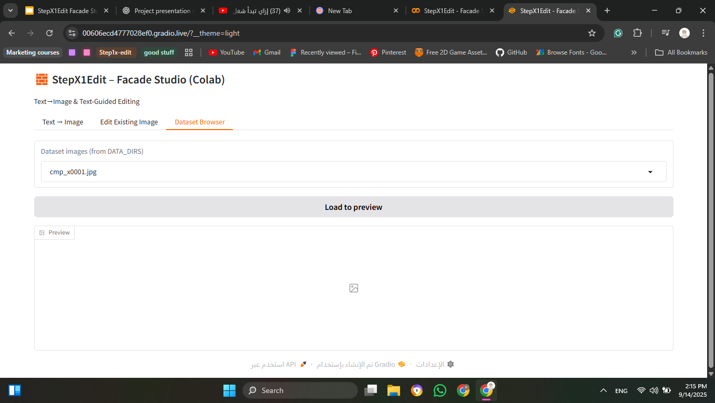
User Interface
Edit Existing Images
Dataset Browser

Slide 10
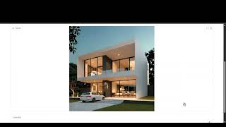
Demo

Slide 11
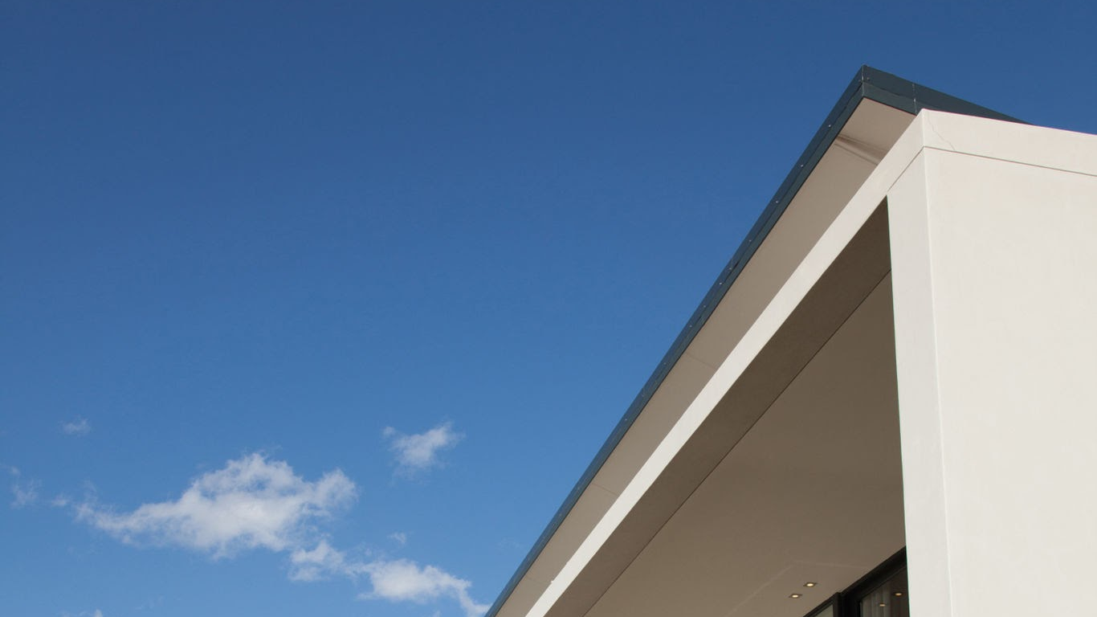

Project roadmap
Step 01
Step 02
Step 03
Step 04
Research & Setup
Identified a challenge in the facade design workflow.
Collected datasets of facades and architectural images.
Set up the environment with GPU optimizations.
Model Integration
Integrated SDXL-Turbo for fast generation
Integrated Step1X-Edit for instruction-driven edits
Added fallback with Instruct-Pix2Pix
System & UI Development
Built Gradio interface (Text2Img, Edit, Dataset tabs)
Implemented lazy loading, batch mode, mixed precision
Future Enhancements
Expand dataset for more realistic designs
Add 3D / BIM integration for architectural use
Deploy system to the cloud for wider access

Slide 12

Project Timeline — StepX1Edit Facade Studio
Milestones
Month June
Month July
Month August
W1
W2
W3
W4
W1
W2
W3
W4
W1
W2
W3
W4
Research
Specifications
Planning
Design
Development
Training
Assessment
Documentation

Slide 13

Limitations & Future Work
Limitations
Future Work
01
Only 2D images (no structural validation).
Extend to 3D / BIM integration.
02
Occasional semantic mismatches in edits.
Train on larger, domain-specific datasets.
03
Cloud deployment for wider access.

Slide 14

Conclusion
↝
◩
↬
◪
StepX1Edit Studio enables rapid, interactive facade prototyping by combining fast generation and flexible editing in one workflow. It’s a first step toward integrating AI into everyday architectural practice.

Slide 15

Thank you, and I’d be happy to take your questions.

